Slide 1








Using Predictive Analytics for to Associate Tolls and Damages to Customers
Industry Practicum Presentation
April 2025
Ananth Mohan
Farha Shireen
Hsueh-Ning Chao
Shih Min Lin
Tanvir Ahmed Farook
Yao Liu
Yijun Wang

Slide 2


A lot has happened in the last ~3 months
Week off | 20-Jan | 27-Jan | 3-Feb | 10-Feb | 17-Feb | 24-Feb | 3-Mar | 10-Mar | 17-Mar | 24-Mar | 31-Mar | 7-Apr | 14-Apr
Kickoff |  |  |  |  |  |  |  |  | Spring Break
Understanding industry and problem statement
Data understanding
Data preparation
Creating the Model
Final Presentation
Key Deliverables |  |  |  |  | First draft – Tolls Model |  | Final – Tolls model First draft - Damage Attribution Model |  |  | Final - Damage Attribution Model | Final Presentation
Kick-off
Today!
Project
Wrap-up

Slide 3
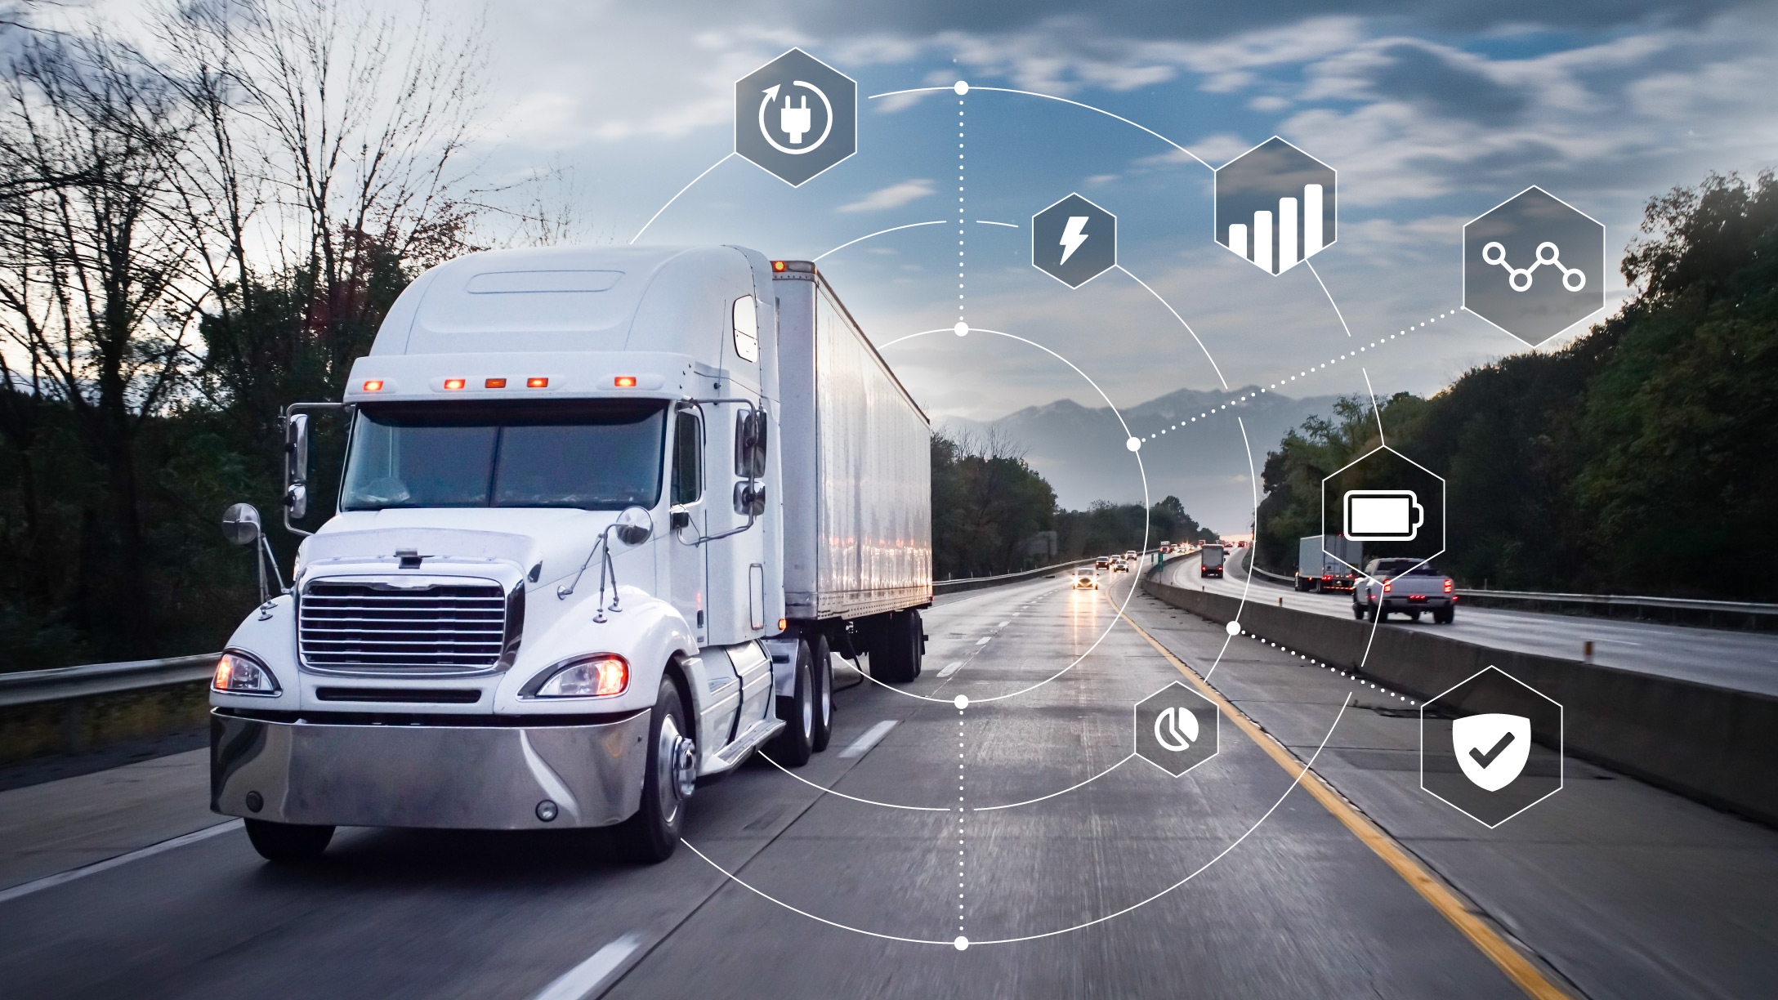
Today, we will cover....
Industry & Overview of the problem
Manage Tolls to improve attribution
Manage Damages to improve attribution
Data Modeling for Predictive Modeling

Slide 4
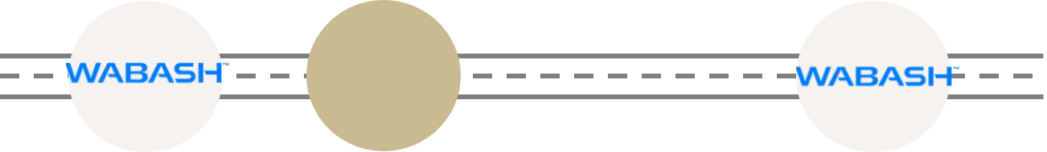
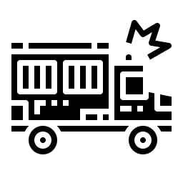
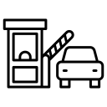


Wabash TaaS revolutionizes logistics, but comes with challenges
Rent trailers to
And they have multiple trips during the subscription period
Subscribers
Subscribers
TaaS
Trailer Subscription
Assets & Service Management
Telematics & Trailer Analysis
Trips
Generate tolls
Cause damage on trailers
Business Problem
Associate tolls and damage to the corresponding parties
Inaccurate billing
Triangulate

Slide 5

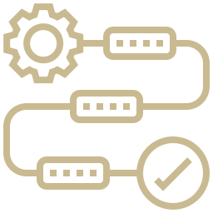

Data for attribution workflows help optimize operations and experience
Automate manual workflows
Accelerate processing times
Enhance operational efficiency
Optimizes workforce expenses
Ensure accurate cost allocation
Mitigate hidden costs (e.g., tolls, damages)
Reduce overall operational expenditures
Streamline Operational Expenditures
Reduce operational disputes
Minimize customer complaints
Enhance satisfaction and foster loyalty
Improves Customer Experience
Notes:
As we continue to refine and enhance the toll attribution process, we have identified three key recommendations that will further improve the process.
First, integrating with the toll system’s API. Currently, toll data must be uploaded manually every day, which is time-consuming and labor-intensive. By successfully connecting to the API, we can automate this process, significantly reducing the time required for data uploads and minimizing the risk of human errors.
Second, continuous monitoring and optimization. While our current solution has improved accuracy, there is still room for enhancement. By closely monitoring toll attribution results, we can identify and correct inaccurate billings in real-time, further increasing accuracy over time and ensuring that customers are always charged correctly.
Third, integrating with the client’s portal. Right now, billing notifications and invoices require additional manual effort. By linking the toll attribution system with the client’s portal, we can automate the sending of notifications and invoices, ensuring a seamless and more efficient billing experience for both the company and its customers.

Slide 6
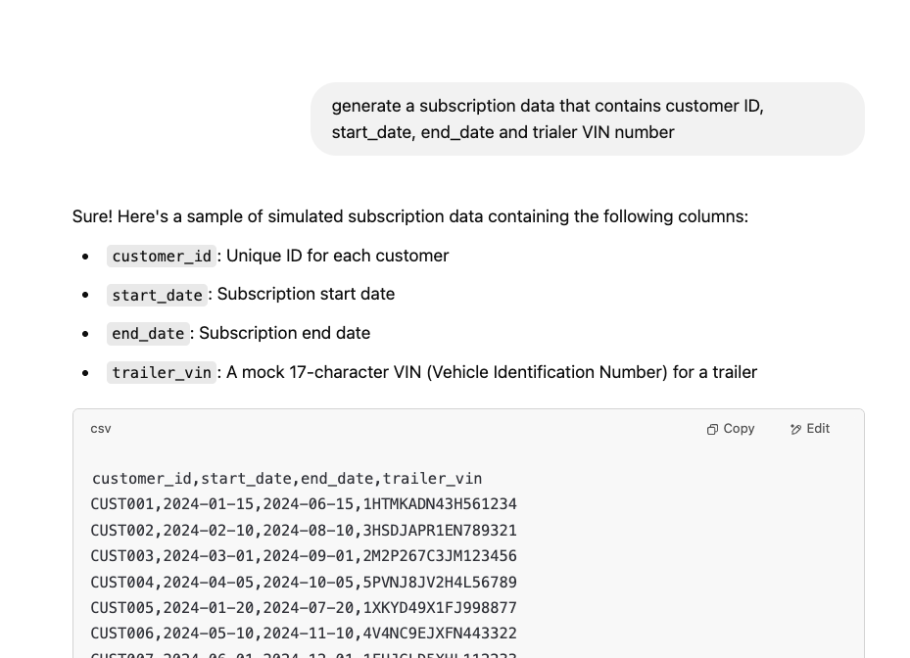
Due to customer confidentiality, we used LLMs to create synthetic data
Raw Data Received from Wabash
Used LLMs to create synthetic data
Asset Location (Telematics)​​
Trailer, Location, Motion Status, Timestamps, ...
Tolls Records Entry/Exit Plazas​​, Toll Charges​​, Dispute Status​​, Timestamps​​, ...
Inspection Records
Inspection Types, User Metadata, Timestamps, ...

Slide 7




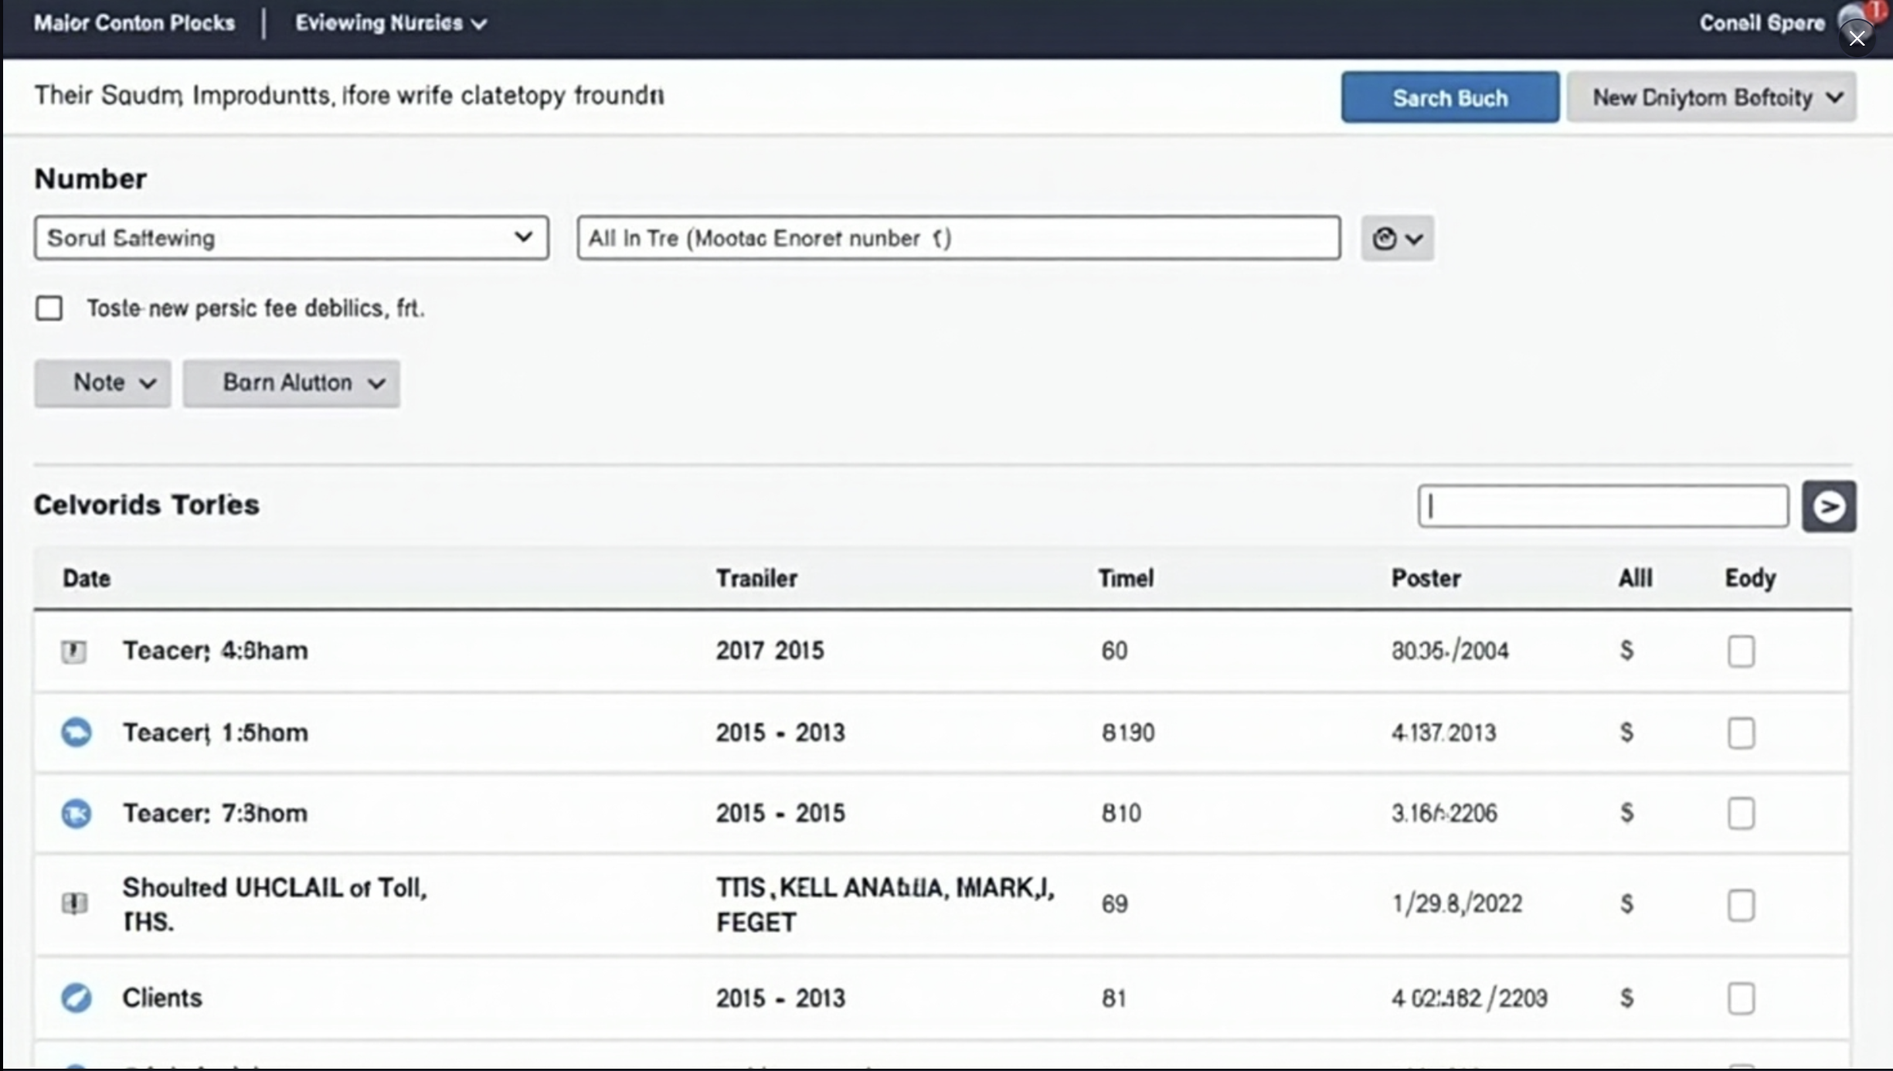
Manual matching of Tolls can cause cost leakage and inaccuracies
Date + UID of trailer
Tolls Data
Subscription Data
Date Filter
Trailer Filter
Manual Attribution
Inaccurate Billing
Toll Attribution
Time-consuming
Revenue leakage
Inaccuracy risk
Search Results
Date
VIN
Toll Amount
Customer_id
Potential Dispute
Billing Delays
Using SQL to match customer to the Toll charge for easy follow-up
Notes:
The toll attribution process is currently being done manually, which takes a lot of time and effort. We identified three key challenges that impact this operation.
First, the process can be extremely time-consuming. Matching toll records with customer subscriptions manually slow down the operation and increase workload.
Second, manual attribution introduces a risk of inaccuracies. With high transactions or having short subscription period, the toll attribution process would be harder and might further cause inaccurate attribution or more missed tolls, which can lead to billing disputes and potential revenue loss.
Third, billing delays make it difficult for Wabash to charge customers in a timely manner. Since the process requires multiple steps before finalizing charges, it affects both operational efficiency and cash flow.
As the business grows, these challenges will only increase. That’s why we developed an automated solution designed to streamline the toll attribution, ensuring efficiency, accuracy, and timely client charges—so you can focus on scaling the operations rather than fixing billing errors.
Our solution works by integrating the subscription data with toll records, automatically matching each toll charge to the correct customer using SQL and batch processing, which allows the system to conduct the matching process repeatedly.
Since the API problem with Prepass haven't been fixed yet, so the first step of this process would be upload the tolls data we received from Prepass everyday and set up Batch to repeat the mapping process daily, after the mapping process is done, the result will be shown in the toll attribution table with date, VIN, toll Amount, Customer ID. This result can further be exported.
After adopting this automation, we estimate that we can increase accurate attribution and time used for this process can be decreased significantly, another key improvement is timeliness. With automation in place, we can now process toll charges much faster, which allows us to bill the customer more promptly.

Slide 8



This solution can be further improved using appropriate integrations
Prepass API
Monitor and Optimize
Integrate with Portal
Successfully connected to toll system's API can reduce the time that are used to manually upload the toll data everyday
Continuously monitor toll attribution results, focusing on identifying and addressing inaccurate billings to enhance accuracy over time
By integrating the toll attribution data with the portal, by sending billing notification and invoices through portal
Notes:
As we continue to refine and enhance the toll attribution process, we have identified three key recommendations that will further improve the process.
First, integrating with the toll system’s API. Currently, toll data must be uploaded manually every day, which is time-consuming and labor-intensive. By successfully connecting to the API, we can automate this process, significantly reducing the time required for data uploads and minimizing the risk of human errors.
Second, continuous monitoring and optimization. While our current solution has improved accuracy, there is still room for enhancement. By closely monitoring toll attribution results, we can identify and correct inaccurate billings in real-time, further increasing accuracy over time and ensuring that customers are always charged correctly.
Third, integrating with the client’s portal. Right now, billing notifications and invoices require additional manual effort. By linking the toll attribution system with the client’s portal, we can automate the sending of notifications and invoices, ensuring a seamless and more efficient billing experience for both the company and its customers.

Slide 9
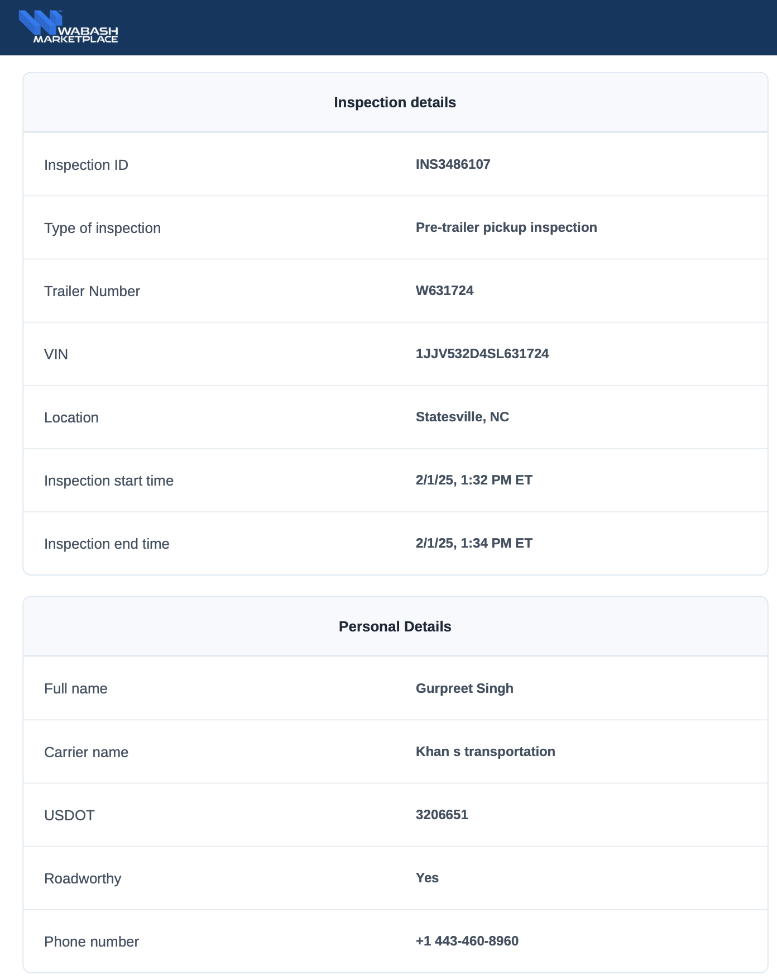

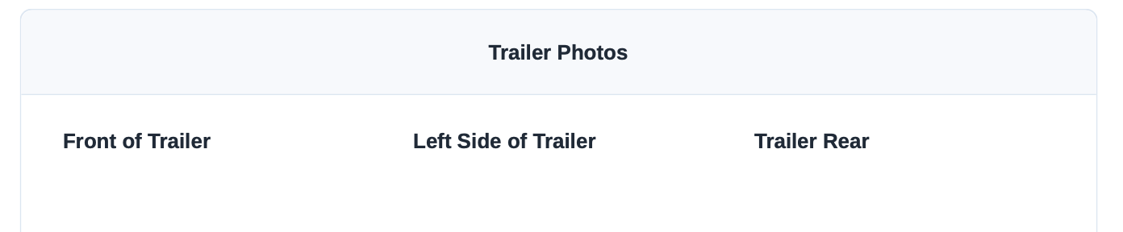

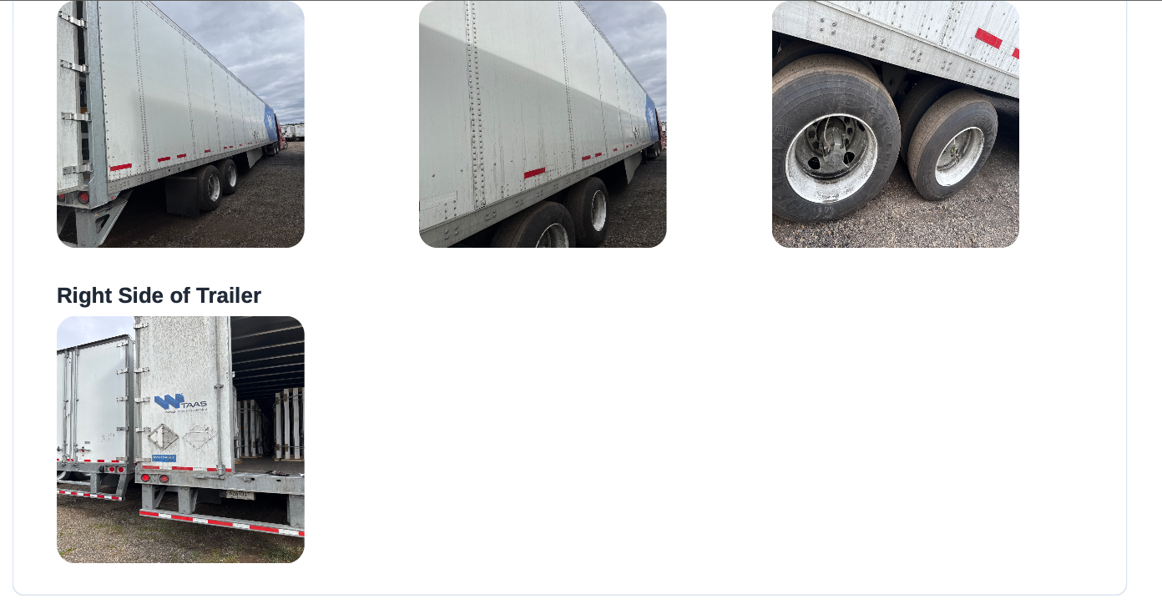

Manual scanning of inspection report is cumbersome and not scalable
Driver adherence to filling inspection reports
Manual Review causes delay and inaccuracies
Frequent trailer handover complicates ownership

Slide 10
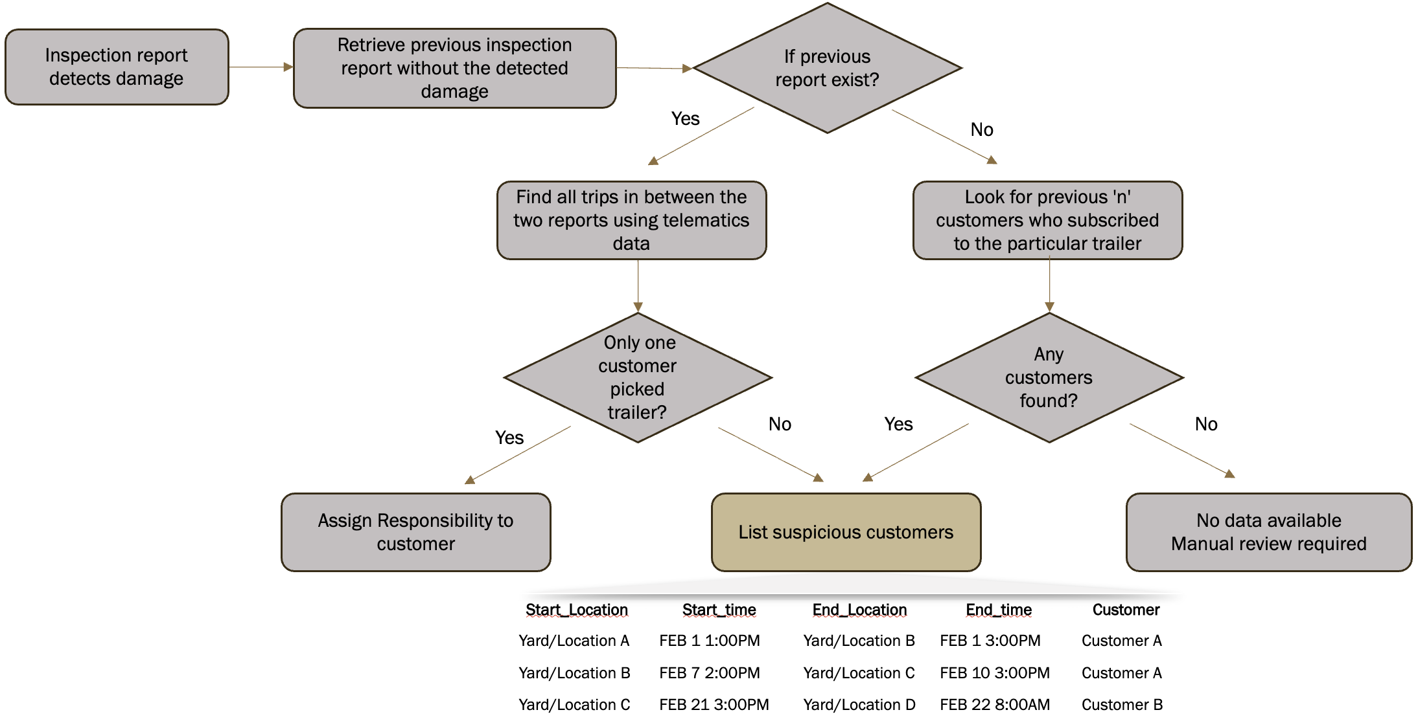
Inspection reports with telematics can provide potential drivers
Key Parts of Damage Solution
Recent Clean Inspection Report as the Starting Point
Matching with Telematics Data
Tiered Attribution Logic
Benefits
Works even if reporting isn’t enforced
Avoids subjectivity, improves accuracy
Enables fairer attribution
Automates damage attribution at scale with traceable outcomes

Slide 11
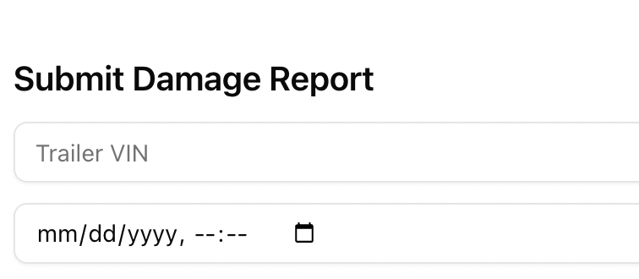
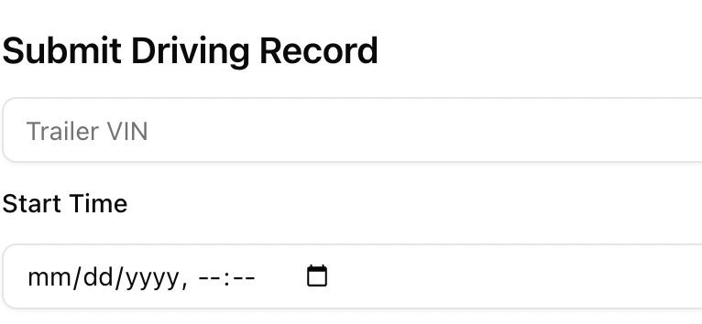
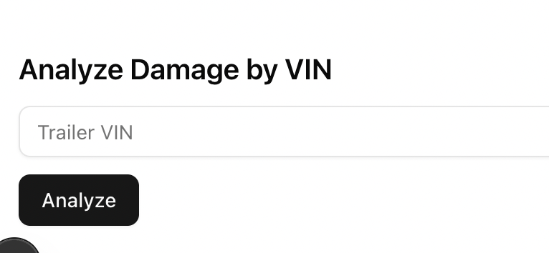
We created a website to demonstrate sample output
Web UI enables inspection and telematics submission
Backend logic matched reports with customer activity
Results are displayed instantly with status + movements

Slide 12




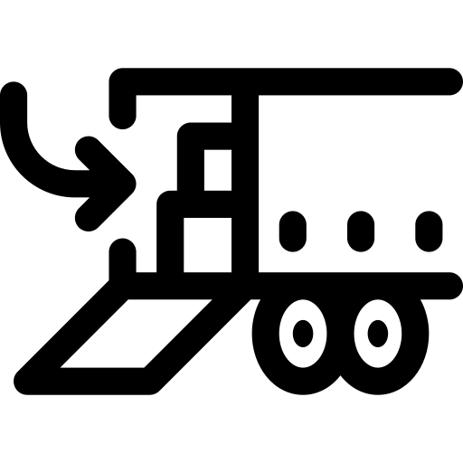


Supplementing data can help find the most likely driver
External APIs
Historical Patterns
Weather
Trip Recency
Time of Day
Sensor
Predictive Model
"Most likely
Driver"!
List of Possible Customers
Overload
Route History
Driver Behavior
Notes:
In the scenario where we have more than one suspicious driver, we would suggest using a predictive model to predict the degree of suspicious for a driver based on the features above, such as the weather condition, time of day, load weight, recency of a specific trip and also use the route history data to see how often does a specific route has damage occurred. After runniung the model, a score will be estimated for each driver based on the features. This score allows us to target the most suspicious driver in the list.

Slide 13
Recommendations on data modeling and how to organize the DB
Drivers
Customer
Tolls
Payments
are done by
requires customer
have to pay
Subscriptions
Trips
takes
includes
should complete
Inspection Reports
Damages
help to track
Trailers
can be tracked
Telematics
Maintenance Records

Slide 14
Capture the right fields for each table to create effective models
Table | Fields (assumes unique ID is present)
Customer | company_name, subscription_status, subscription_length, assigned_trailer
Trailer | vin_number, asset_availability, subscriber, subcribed_length, sensor_related_fields
Subscription | subscriber_name, start_date, end_date, subscription_type
Trips | subscription_id, vin_number, start_time, end_time, departure_network, return_network, toll_pass
Drivers | driver_name, company_name, vin_number, departure_time, arrive_time
Tolls | vin_number, entry_date, exit_date, toll_charge
Payments | company_name, trip_id, report_id, invoice_date, payment_status, total_fee
Inspection Reports | report_id, vin_number, company_name, inspection_type, damage_or_not, created_time
Damages | vin_number, damage_part, severity, report_date, charge_back, responsible_customer, estimate_cost
Telematics | vin_number, position, asset_motion_status, report_time
Maintenance | Maintenance_id, report_match, maintenance_status, maintenance_cost, start_date, finished_date, charge_back

Slide 15

Roadmap from data collection to data-driven
1 - Foundational Data
2 – Understanding the Data
Preparation & Pipelines
Set up robust ETL pipelines using tools like Airflow, Fivetran, or dbt
Automate data ingestion and transformation
Track data lineage and version history
Exploratory Analysis
Conduct descriptive statistics & data visualization
Identify trends, anomalies, outliers and their reasons
Feature Engineering
Use Domain-specific knowledge to transform raw data into meaningful features
Relevance & Representativeness​
Collect the right data aligned with business and modeling goals​
Integrity & Quality​
Validate accuracy, consistency, and completeness​
Structure & Storage​
Use standardized schemas and naming conventions​
Store data in scalable, cloud-friendly systems like BigQuery or Snowflake​

Slide 16

Advanced modeling can help manual efforts and improve accuracy
3 – Advanced Modeling with Data
What
How
Why
>
Automate toll updates and payment tracking
Integrate toll, trip, and payment data to build a real-time status engine using rule-based and ML logic
Save operational time and reduce billing errors
>
Identify damage-prone situations and trigger alerts
Analyze trip conditions, speed, route data, sensor data and past incidents using anomaly detection models
Avoid breakdowns and plan servicing proactively
>
Predict trailer maintenance needs using sensor data
Use time-series modeling on telematics and sensor data (e.g., temperature, vibration) to forecast failure points
Reduce maintenance costs and improve trailer uptime
>
Profile driver behavior from telematics data
Aggregate acceleration, braking, and deviation data to score drivers using clustering or supervised models
Improve safety, assign risk scores, and incentivize good driving​​

Slide 17

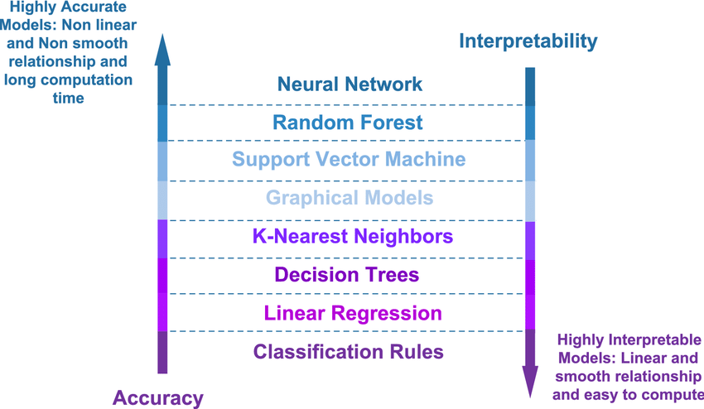

Turning Data into Trust: From Costly to Intelligent
Highly Accurate
Models: Non-linear and non-smooth relationship and long computation
time
Damage attribution goes beyond billing — it's about establishing trust and good driver practices
Wabash can lead by delivering fairness, transparency, and intelligent insights in TaaS
Highly Interpretable​ Models: Linear and smooth relationship and easy to compute
Human attribution demands interpretable models to shift from reactive responses to predictive intelligence

Slide 18
can we clarify anything?
Thank you for your Attention!

